Slide 1
Exploration: CUSUM + Interactive Dashboard
Digital Divide Under COVID
10/28/21 | KG

Slide 2
Data Preparation and Analysis
Found percent total responses saying a computer was never available for educational purposes (COMPAVAIL variable)
Weeks 1-33 (they stopped asking about this after that point)
Accounted for survey weights – see instructions
Disaggregated for Black and White households
Found the difference between the % totals for each week
Used start of survey period as date (manually entered)
CUSUM (qcc package in R)
Detected change in the disparity (difference between % totals)
Used biweekly data (survey starts off weekly then switches to biweekly)
Center = average of data
Window for detecting change = +/- 3 standard deviations from center

Slide 3
Preliminary Tableau Dashboard Prep
Made one graph – 2 different ways
Line chart showing the percent of total responses saying a computer was never available over time disaggregated by race
To show where the change was detected:
Slide 4: green/grey shaded background
Slide 5: notes if change was detected in tooltip
Interactivity:
Slide 4: tooltip only
Slide 5: tooltip and reference line that moves on selection of data point and with drop down selection (see upper right)

Slide 4
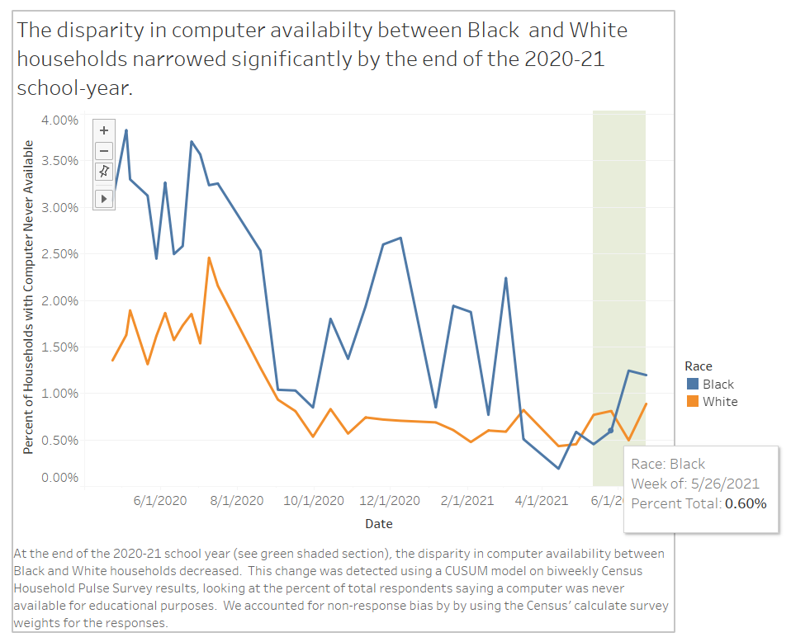

Slide 5
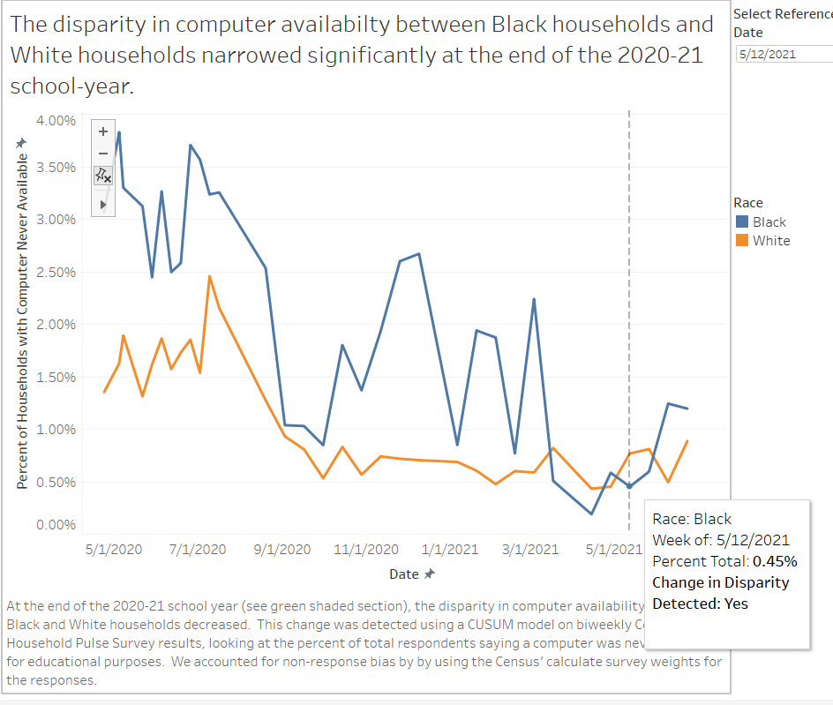

Slide 6
Challenges
Difficult to add more interactivity and user options because it is hard to update the change detection information for updated graphs.
Difficult to make multiple graphs/sheets and select one to view
This is finicky in Tableau. When you select different graphs/sheets, the titles, captions, and legends for the other graphs still stay.
Difficult to have multiple groups (e.g., White, Black, Hispanic, etc.).
It might get confusing to account for the changes detected for each group if they are all in one graph.
Even if we did one race/ethnicity at a time, it would be difficult to add a filter for different groups because I couldn’t figure out a way for to get the grey/green bar to move automatically.
Reference line is limited:
I can’t get the color to change if a change was detected or have more details in the reference line specific tooltip. The tooltip shown in slide 5 is for the point itself.

Slide 7
Possible Design of Experiments/Evaluation
Ideas regardless of if we do a similar layout to what I tried
Have some way to evaluate that the change we detected is indeed a change detected.
Not sure what this would look like, but I’m wondering if there’s some calculation we can do to verify that the output of the change detection model and that we used the best “inputs” for the model
User survey
If we do this, we’d need to have a rough dashboard ready and implement it in time to get results before the final deadline.
User interviews
Not sure if this would be “experimental” or “quantitative” enough, but it might be easiest if each of us just sat down with someone, walked through the dashboard and got direct feedback/suggestions

